Slide 1



FPGA Setting Using Flash
Project goal:
Creating a data base stored in a FLASH memory.
The data based is used for automatic configuration of hardware clients.
Such a system is compact, fast and software independent.

Slide 2

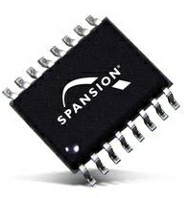
Description
Hardware clients operate by configuration written into their registers
Software updates a data base, defining a system configuration in a FLASH memory
FPGA setting using FLASH system automatically reads data base from FLASH and configures hardware components
FPGA setting using FLASH system
FLASH memory
Software
Independent!
registers
Software Host:
MATLAB GUI
Hardware System

Slide 3

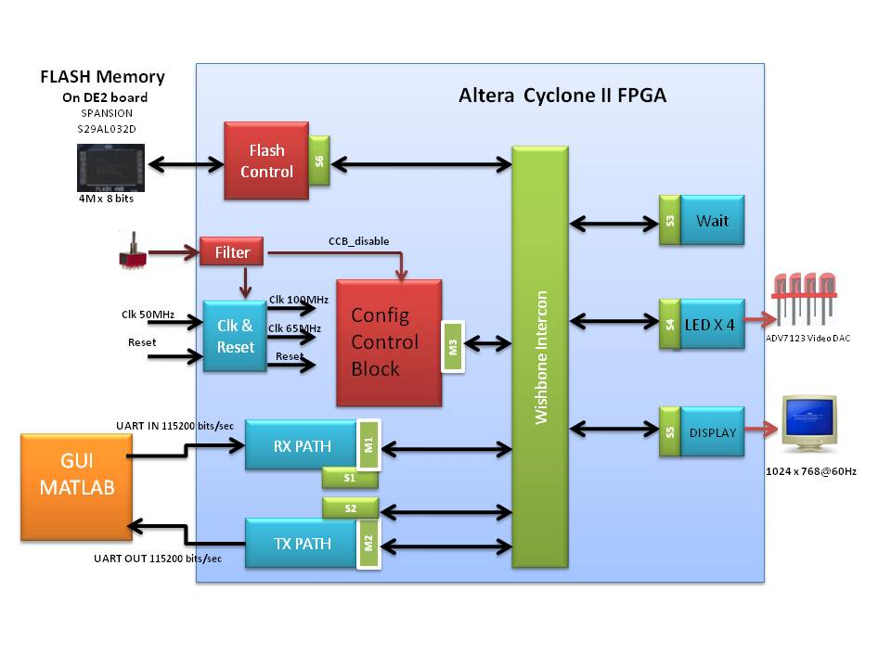
TOP Architecture
Notes:
תמונה של המערכת
הדגמה של מעבר מידע מההוסט לפלאש ומהפלאש ללקוחות
נסמן בצבעים את היחידות שאנחנו עשינו implemented
בצבע אחר את היחידות שקיבלנו integrated בצבע אחר את היחידות שעוד לא מימשנו not implemented

Slide 4
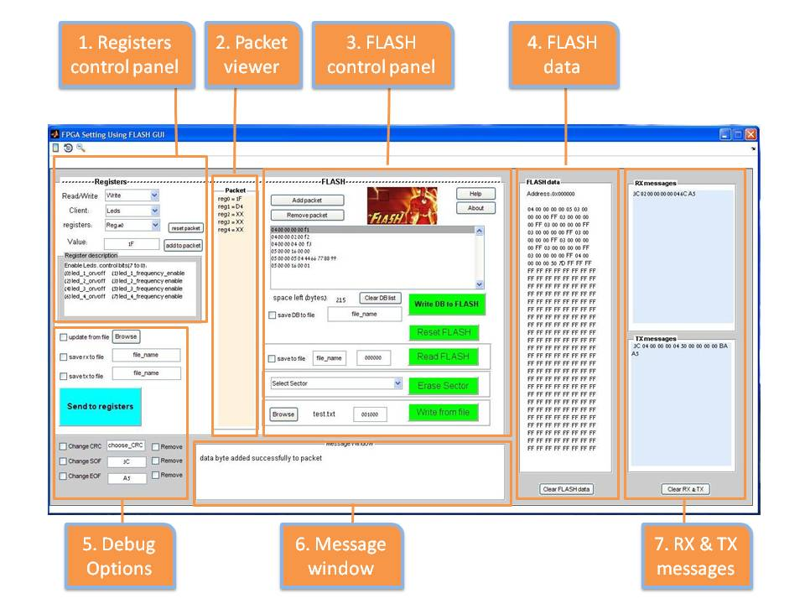
MATLAB GUI

Slide 5
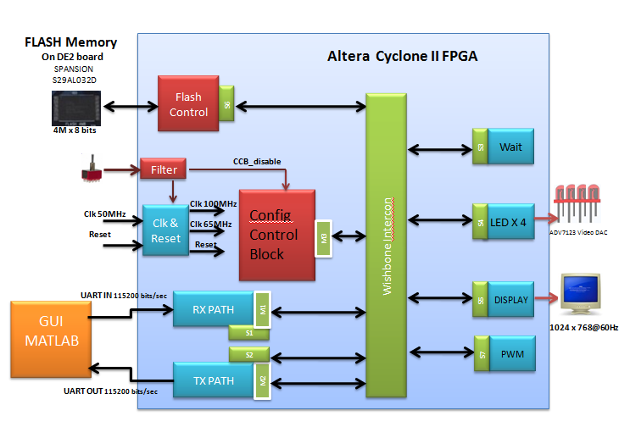
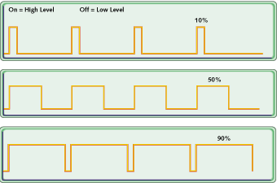
Possible Application
Any hardware client can be connected to the system if it possesses a Wishbone Slave connection. Such a client could be a Pulse Width Modulator (PWM) . A PWM can define a unique frequency for many servo controllers.
In order to prevent the case that on system power on there would be some default insufficient value on the frequency input of servo devices, the PWM will function as a client of the FPGA setting using FLASH system.
Data would be loaded from the Flash memory for correct configuration.

